Slide 1
FYP MEETING
ISD 02
Sem B 1 ST Meeting

Slide 2

Our Logo Design

Slide 3
Logical Design Definition
The logical design of a system pertains to an abstract representation of the data flows, inputs and outputs of the system. This is often conducted via modelling, using an over-abstract (and sometimes graphical) model of the actual system. In the context of systems design are included. Logical design includes ER Diagrams i.e. Entity Relationship Diagrams.

Slide 4
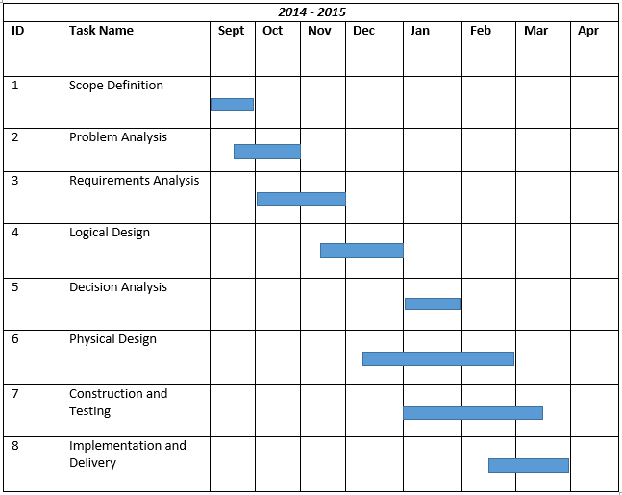

Slide 5
Agenda
->Logical Design Definition and Some Functions Explanation
->Result outcomes from difference members

Slide 6
Set up background of timetable
Provides various of choices for setting the background:
1)can track the photo from websites.
2)can track photo directly from camera
3)can track photo from Computer.

Slide 7
Voice could toatally for highly applied Usage of Database
The clarification of how our fyp project for use of database:
It ‘s assumed the system need to read aloud the datum seperately.
The read aloud data should be in hirearchical orders
(such as TIME->EVENT NAME->PLACE)
(E.G. 2:00-3:00 AST10106(L01) AC2 1614 )

Slide 8
REASON FOR SEPERATION
1)for skipped option provided for listening tape
It ‘s impossible for directly loading datum from google system.
If directly load,many of bugs and memory required ,thurs DATABASE OPERATED.

Slide 9
REASON FOR SEPERATION
2)For stored background image that users like
It ‘s obvious indicated that users like to input their background image.
For storing pictures,database has its effects.

Slide 10
ER Diagram of Project
therefore we have following entities contains:
1.Activity Entities
2.Activity Detail Entities
3.Account Entities(for login useage)
4.Profile Entities

Slide 11
TASK FOR US DOING
Design and Layout perspective:(Phys Design)
Upon Work:Design the layout with responsive web design for users and formal page for Adminstrators.
Done Part:
1)Main Page Design(Client ONE with Recent New Page)
2)Adminstrator’s Website (Layout Only without functions applied)
Furture:
Login Page(Detect word for input and identify wrong places),Make Main Page be more beauty(Slideshow for replaced?),CSS3 Schedule,Personal Info Page

Slide 12
Database perspective:(plan)
1.Data Used and description(by talking,because used for docunmentation)
2.Database build up,or etc

Slide 13
Programming Perspective:
Things that will probably do in the future
1.How to send the datum to the server
2.How to send the voice from server to clients
3.Main Program Writing and Function
4.After transfer to database from server and how to convert word to voice from DB.

Slide 14
Useful Article:
http://patw.idv.tw/blog/archives/619/c-net-use-text-to-speech-in-microsoft-speech-sdk-11lai-function
http://blog.csdn.net/hfahe/article/details/8511238

Slide 15
Server Perspective:
Plans to do:
1.how to save the datum through server and loading the datum effectively,
2.Voice output for the event detail from server system

Slide 16
Docunmentation Perspective:
1.Correction to formal form of Minutes(For all Conferences)
Furture Work:
2. draw the EAR Table by DeZign
3.Summarize and explain functions of program briefly.

